Slide 1
State and Economy
Rafael Marques

Slide 4
Development Models

Slide 8
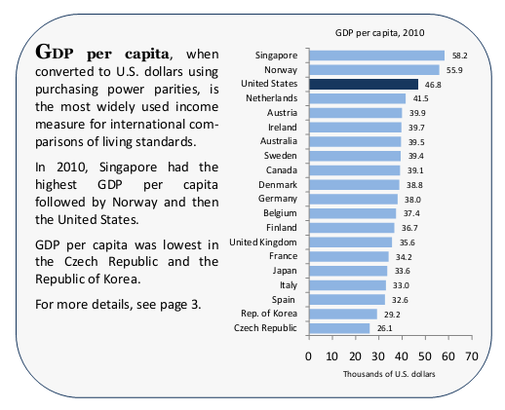

Slide 9
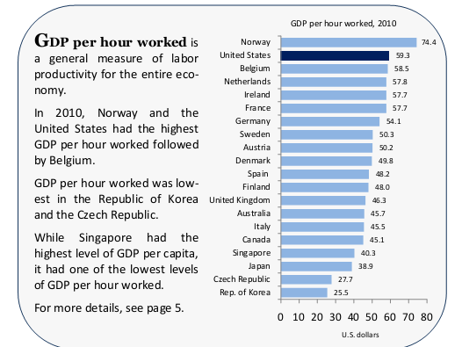

Slide 10
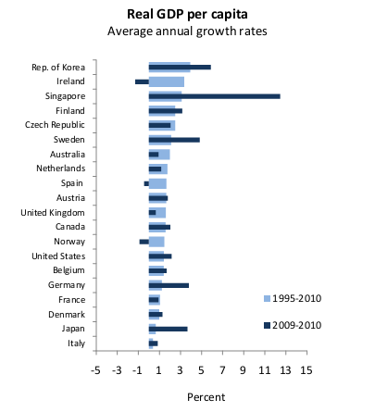

Slide 11
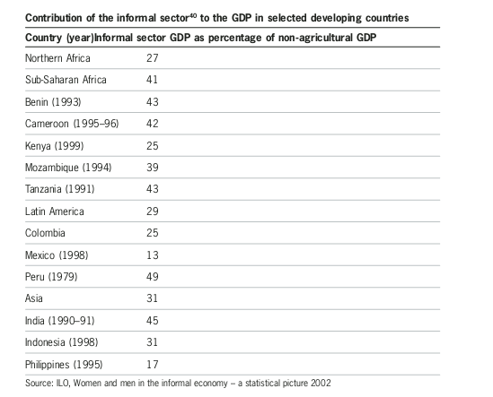

Slide 12
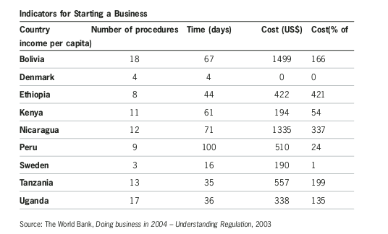

Slide 13
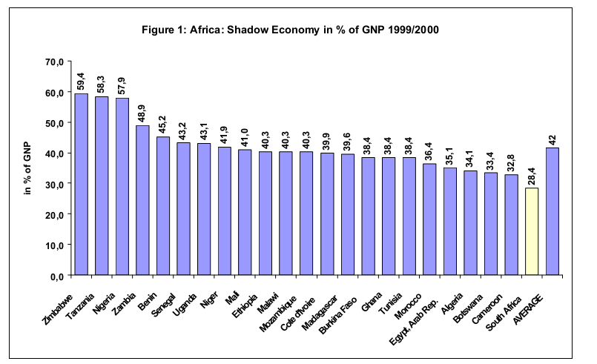

Slide 14
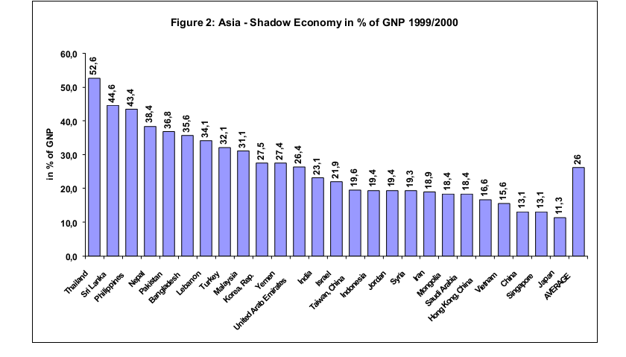

Slide 15
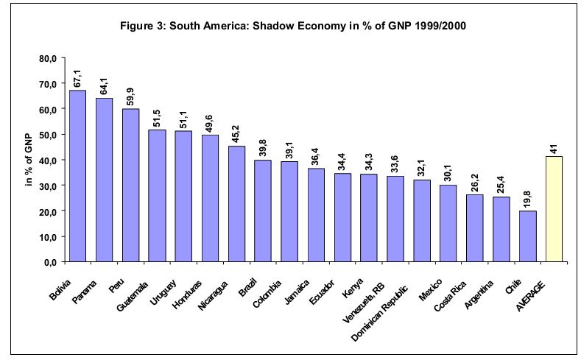

Slide 16
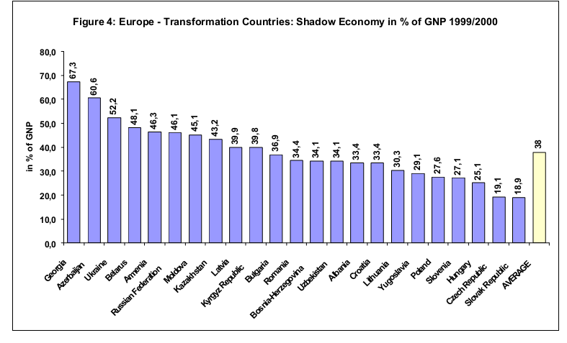

Slide 17
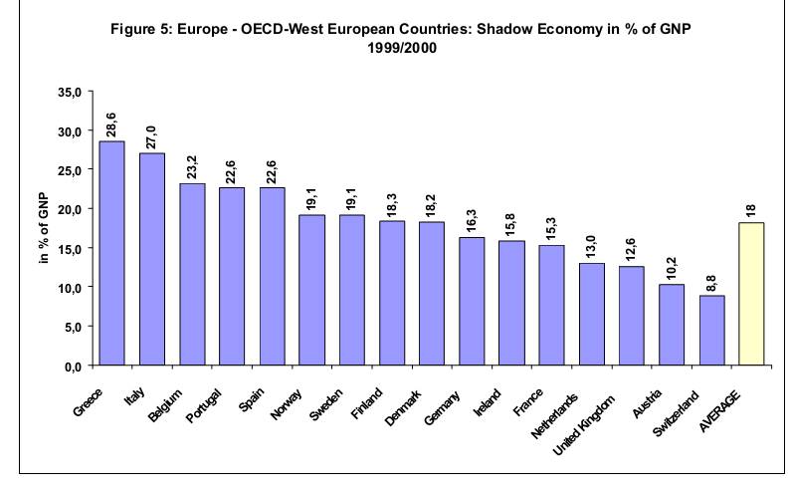

Slide 18
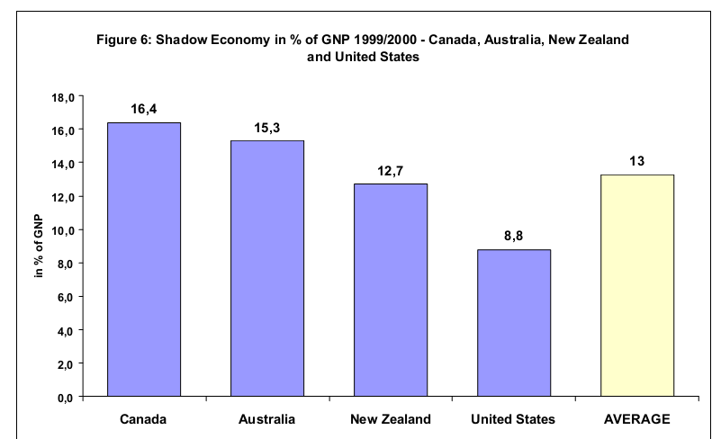

Slide 19
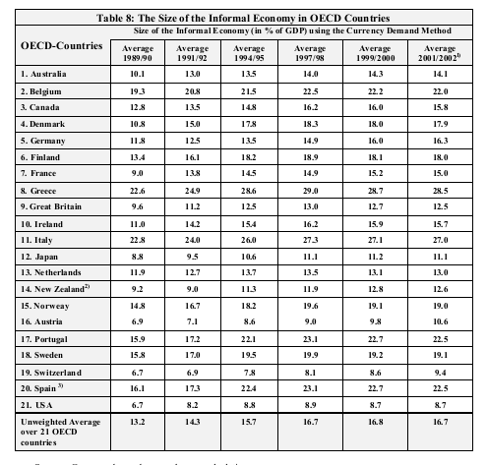

Slide 20
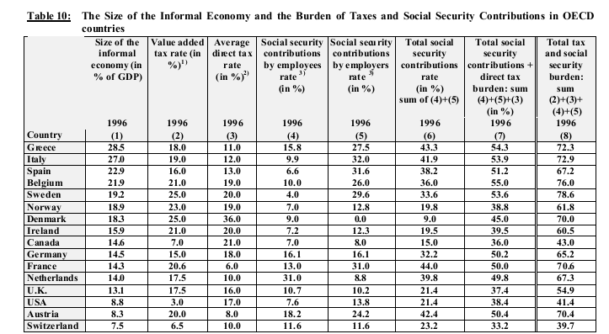

Slide 21
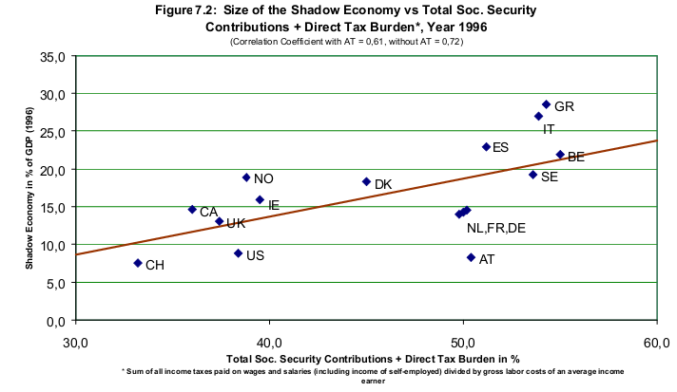

Slide 22
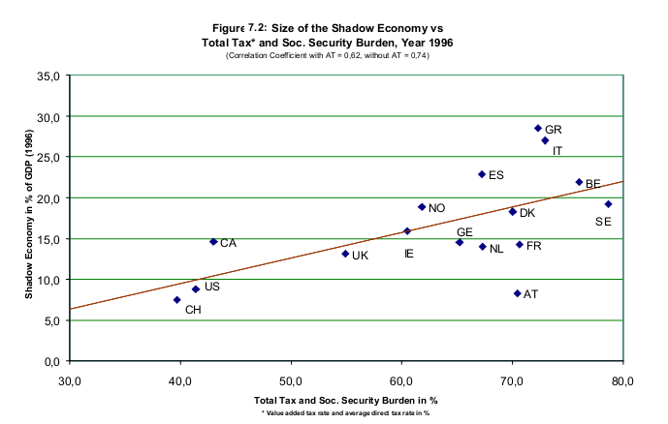

Slide 23
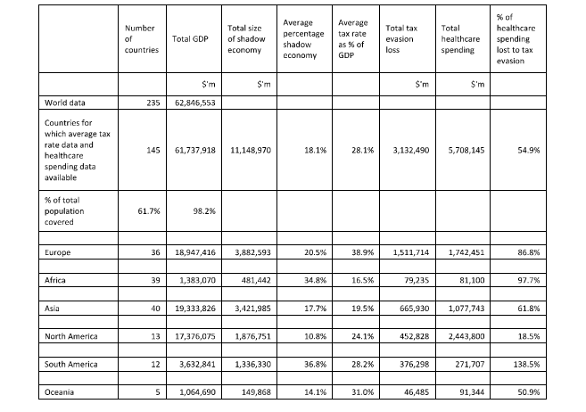

Slide 24
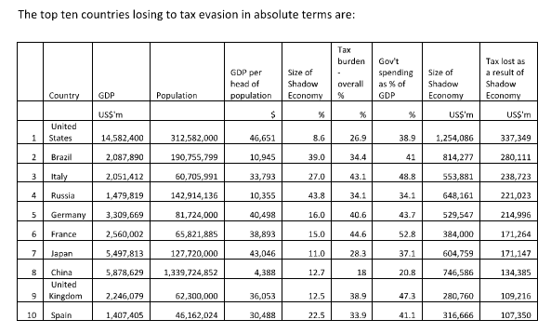

Slide 25
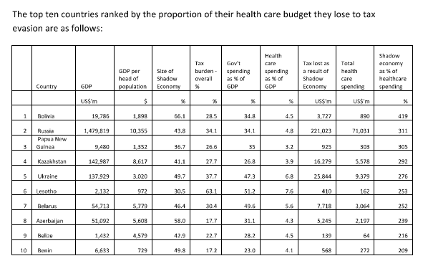

Slide 26
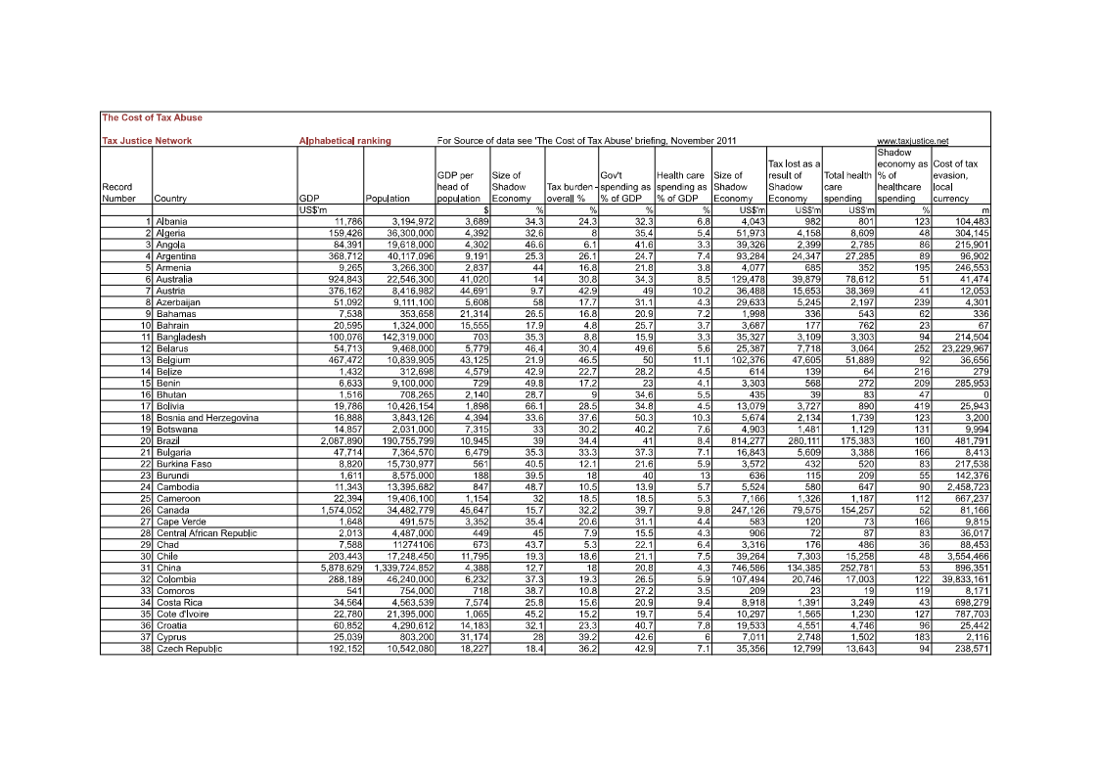

Slide 27
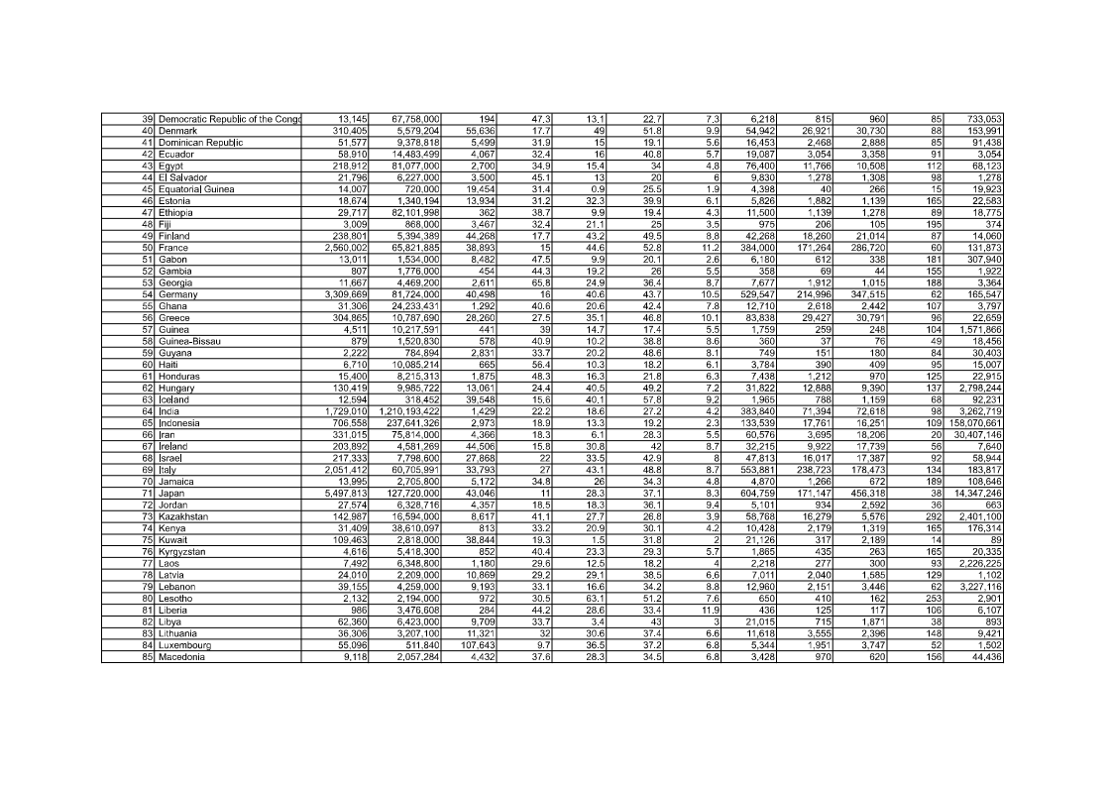

Slide 28
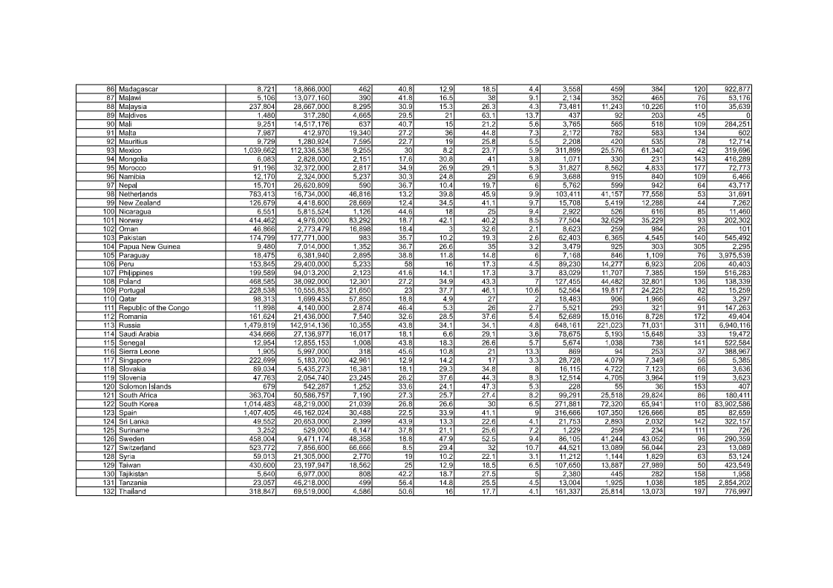

Slide 29
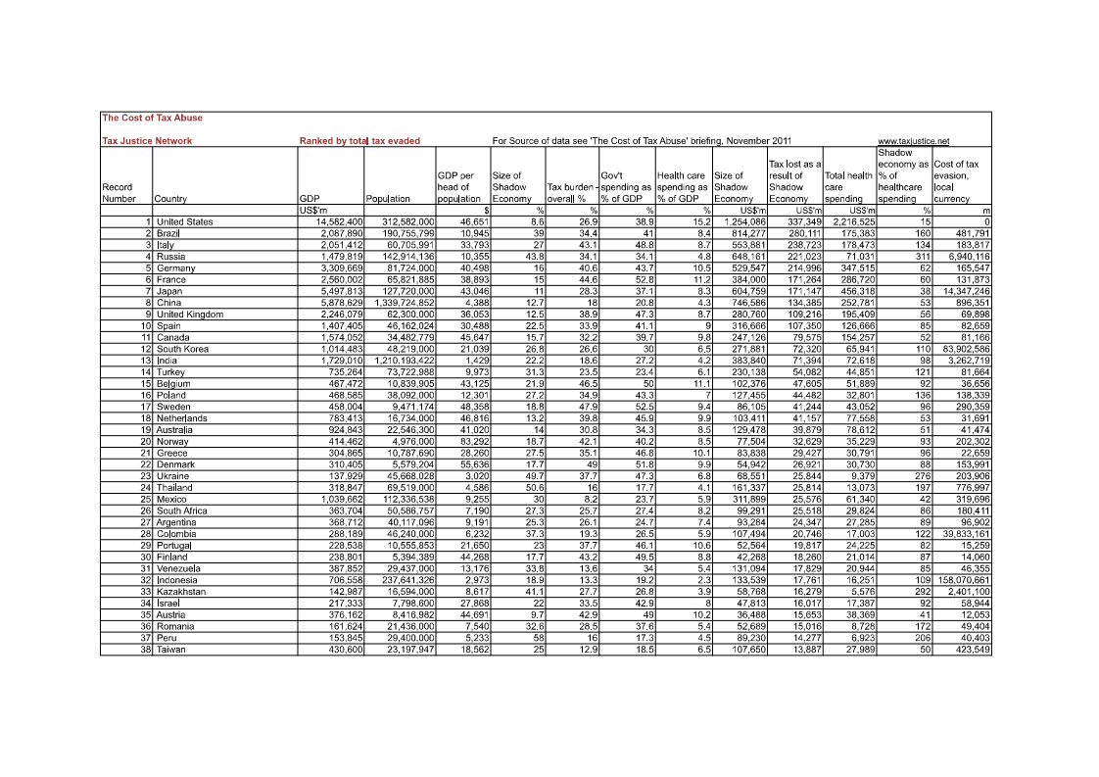

Slide 30
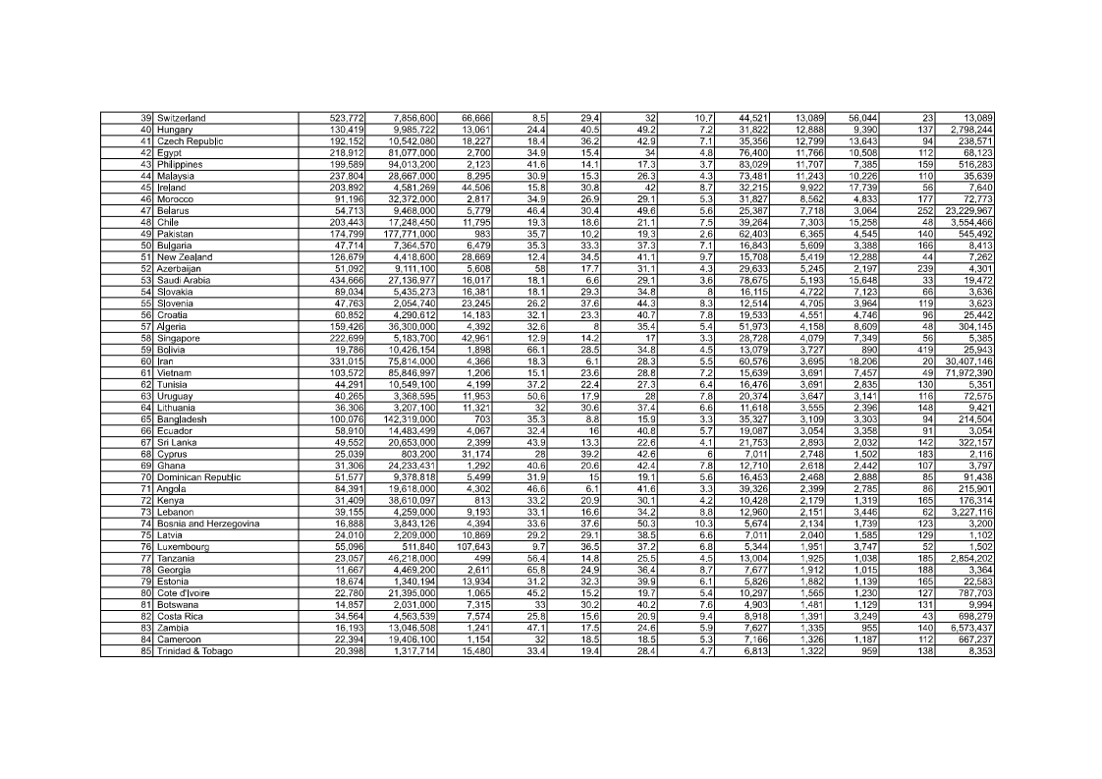

Slide 31
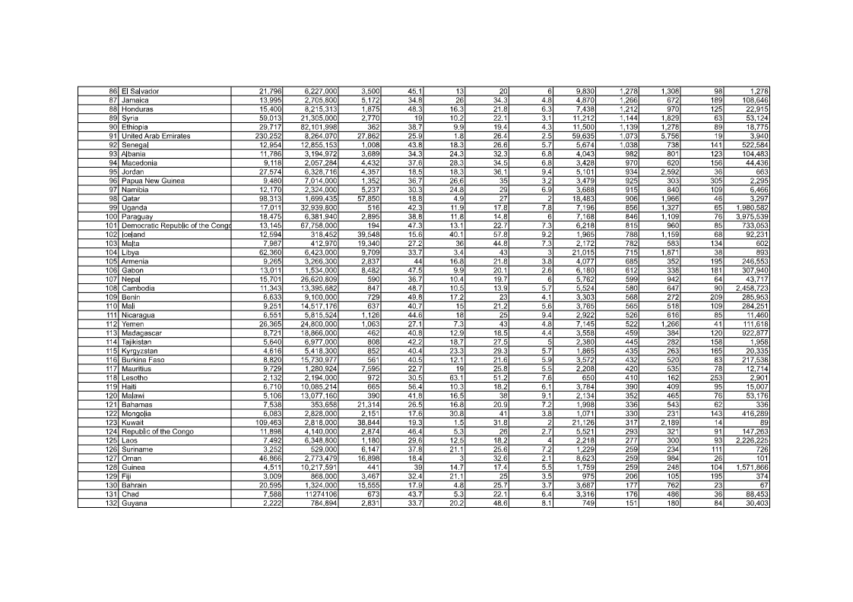

Slide 32
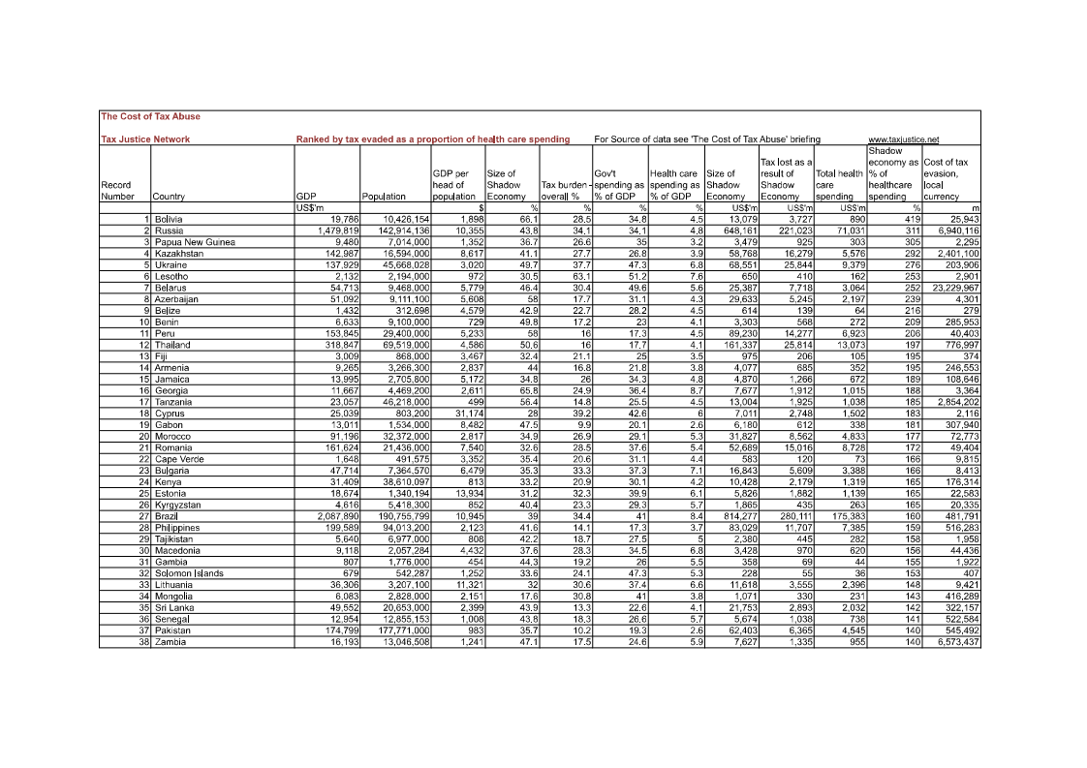

Slide 33
http://cpi.transparency.org/cpi2011/results/#CountryResults
http://en.wikipedia.org/wiki/Corruption_Perceptions_Index
http://en.wikipedia.org/wiki/List_of_countries_by_Human_Development_Index

Slide 34
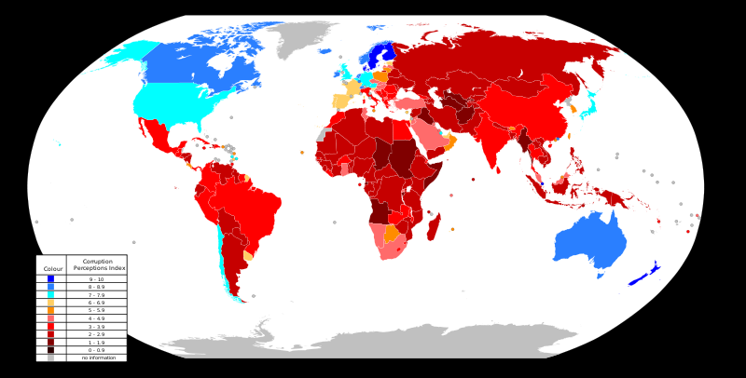
c

Slide 35
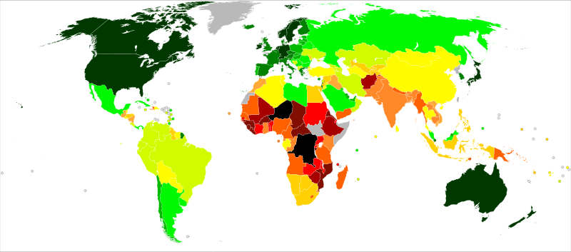
Human Development

Slide 36
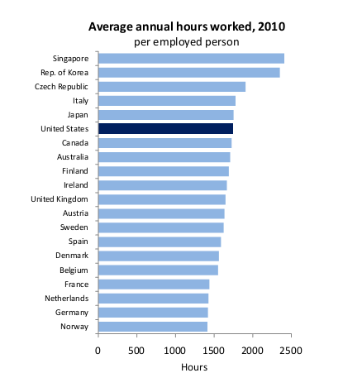

Slide 37
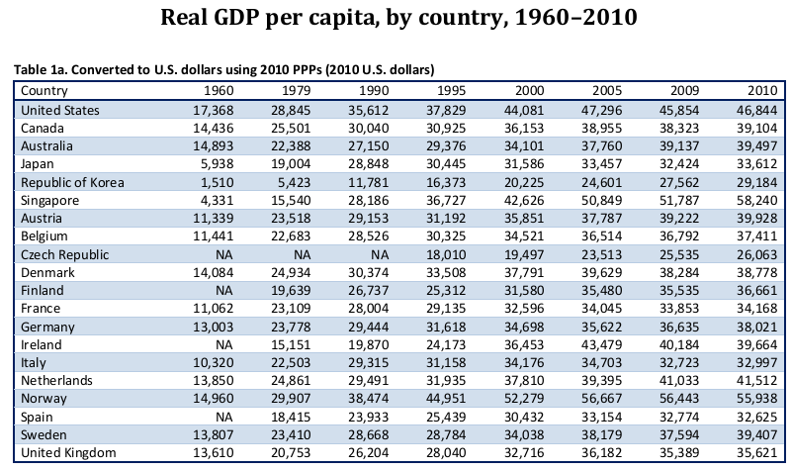

Slide 38
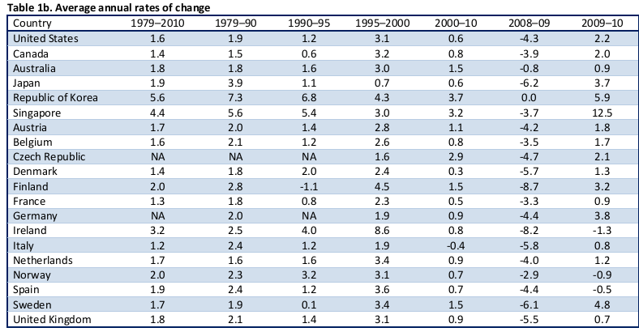

Slide 39
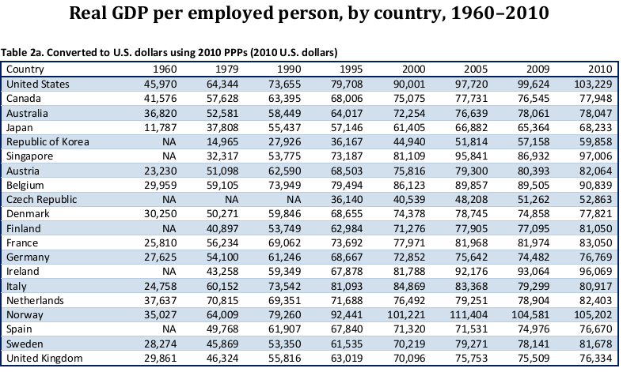

Slide 40
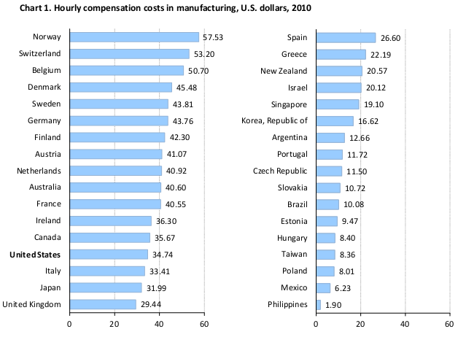

Slide 41
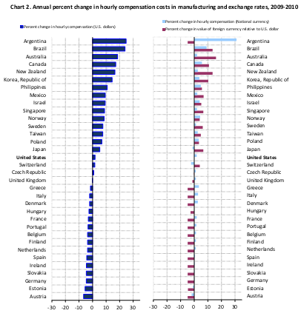

Slide 42
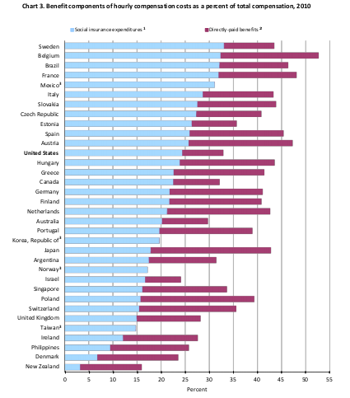

Slide 43
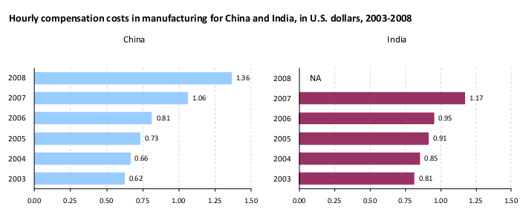

Slide 44
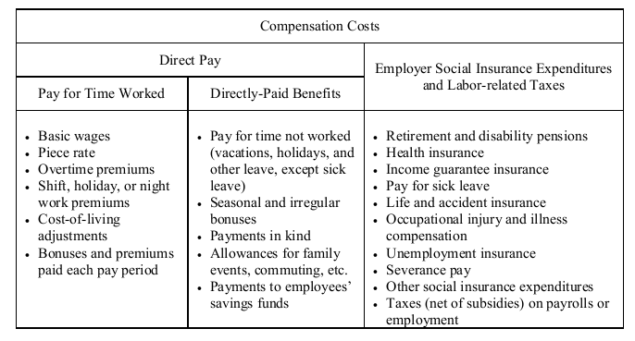

Slide 45
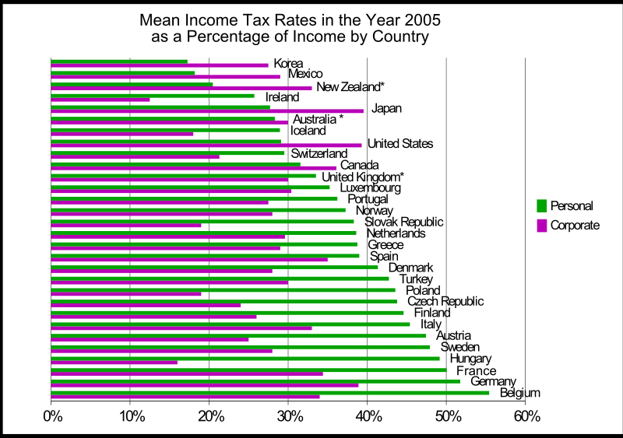

Slide 46
http://en.wikipedia.org/wiki/List_of_countries_by_tax_revenue_as_percentage_of_GDP
http://www.wageindicator.org/main
http://www.worldsalaries.org/total-personal-income.shtml

Slide 47
Countries/Companies
http://www.forbes.com/global2000/list/
http://money.cnn.com/magazines/fortune/

Slide 48
http://en.wikipedia.org/wiki/Satisfaction_with_Life_Index
http://en.wikipedia.org/wiki/Legatum_Prosperity_Index

Slide 49
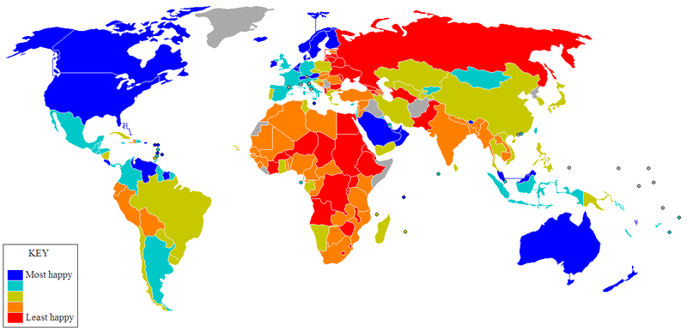
World Happiness

Slide 50
